Slide 1

Strategies in the
Job-Search Process
CHAPTER NINE

Slide 2
Overview
Building a network of contacts
Identifying appropriate jobs
Finding your employer
Preparing application documents
Preparing for interviews
Writing follow-up messages
Continuing job search activities

Slide 3
Building a Network of Contacts
Broaden your circle of friends.
Get to know your professors.
Meet business executives.
Make contacts through internships.
Work with community organizations.

Slide 4
Identifying Appropriate Jobs
Analyze yourself.
  Education
  Personal Qualities
  Work Experience
  Special Qualifications
Analyze outside factors.

Slide 5


Finding Your Employer
Career Centers
Network of Personal Contacts
Classified Advertisements
Online Sources
Employment Agencies
Personal Search Agents
Web Page Profiles
Prospecting

Slide 6
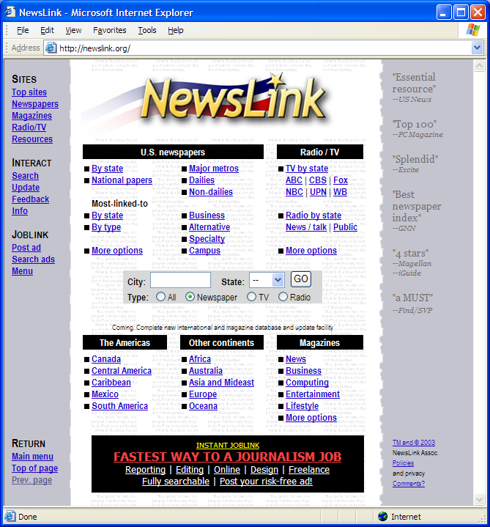
Find classified advertisements online. <http://newslink.org/>

Slide 7
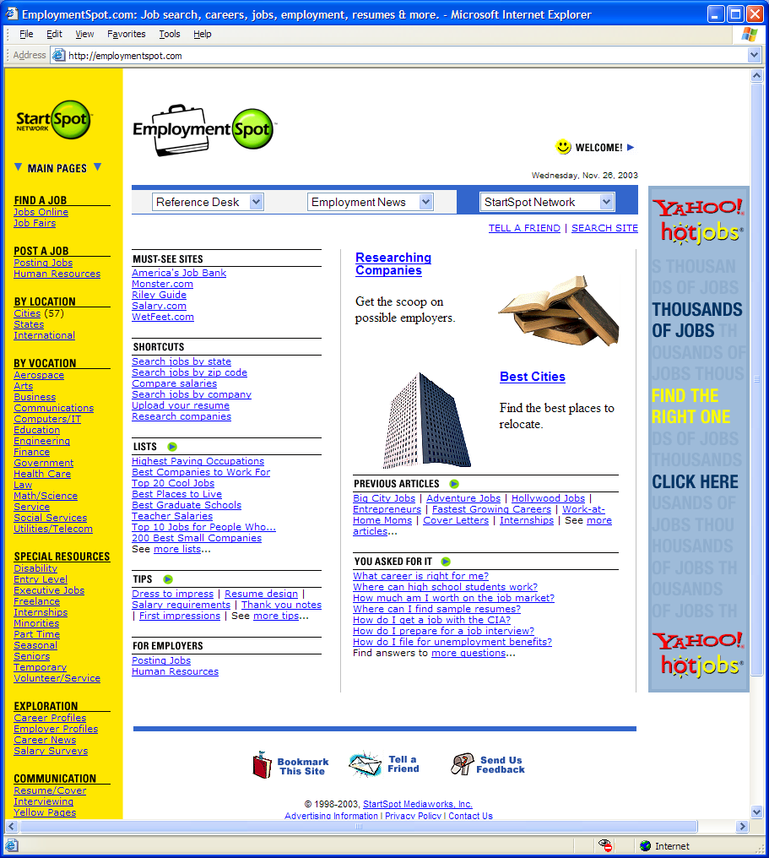
Use online job webliography sites. <http://employmentspot.com>

Slide 8
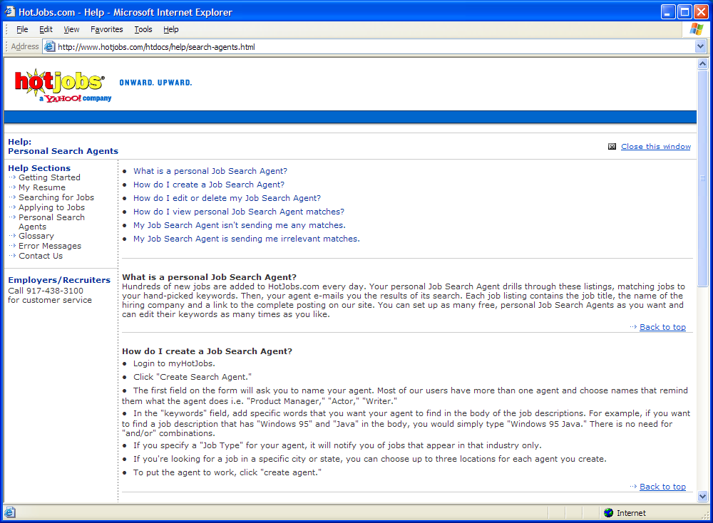
Set up personal job search agents.

Slide 9
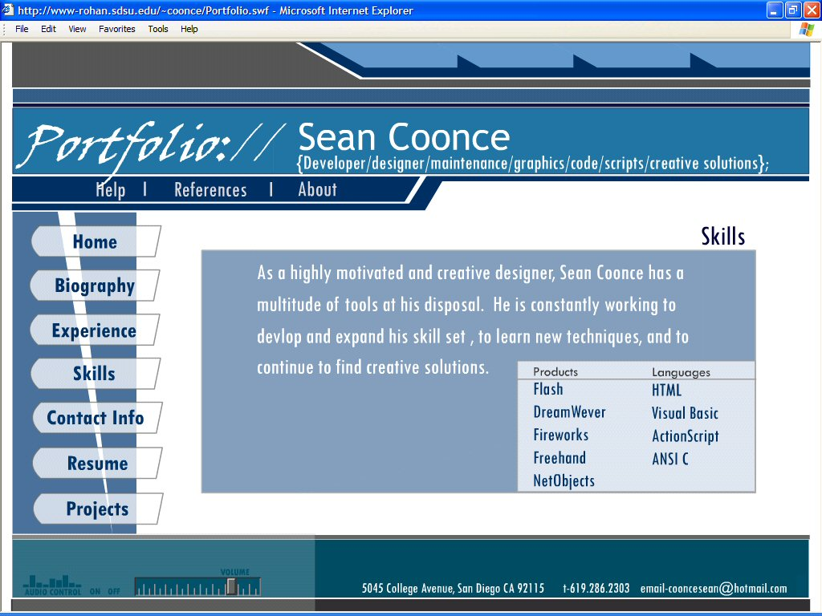
Use web page profiles for enhanced exposure.

Slide 10
Preparing the Application Documents
The traditional print résumé
The scannable print résumé
The electronic résumé (such as ASCII, pdf, html)
The reference sheet
The cover message—print and email

Slide 11

The Traditional Print Résumé
Select the background facts.
Arrange the facts into groups.
Construct the headings.
Include contact information.
Include a statement of objective.
Present the information.
Organize for strength.
Write impersonally and consistently.
Make the form attractive.
http://www.paperworks.com/resume.htm

Slide 12
Traditional Print Résumé Example: Chronological Organization
Jere Bacon
7431 Davenport Drive
Dallas, TX 75226
jbacon@yahoo.com
512.598.9693
512.598.0017
Objective: Administrative Assistant Position
Education: Bachelor of Science in Business Administration
Northern State University
GPA 3.0 (4.0 basis)
Computer Skills:
Keyboarding at 90 wpm,Word, Outlook,
Excel, Oracle and Access
Relevant Courses:
Business Writing Interpersonal Relations
Document Imaging Management

Slide 13
continued
Experience:
Secretary 2003-present
Boatner King Insurance Company, Dallas
Personal secretary to Mr. Carlos Boatner, President
Data-entry Clerk 2000-2003
Thatcher Manufacturing Company, Dallas
File Clerk 1999-2000
J. C. Douglas Wholesale Company, Dry Creek
References:
Will gladly provide personal and professional references
on request.

Slide 14
Scannable Print Résumé
Include industry-specific keywords.
Choose precise nouns over action verbs.
Present in a scanner readable form.

Slide 15
Scannable Print Résumé Example
Megan Rosenbloom
3145 Sleep Hollow
New Bedford, MA 02746
954.301.4607
meganr@yahoo.com
KEYWORDS: Office Manager, Office Support, Administrative Office Assistant, Clerical Support, Outlook, Word, Excel, PowerPoint, Access,Telephone Etiquette, Voice Message Systems, PIMs, Project Management
EDUCATION
Bachelor of Science in Business Administration, May 2005
Eli Mason University, New Bedford, MA 02746
Emphasis: Management Minor: International Business
Major GPA: 3.3 (4.0 basis)

Slide 16
continued
SPECIALIZED COURSES: Office management, business communication, business law, human relations, human resources management, and organizational behavior.
EXPERIENCE
Office Clerk 2001-present
J. J. Webb, Inc. (wholesale grocers), New Bedford
Maintain inventory, supervise two clerks, report to purchasing manager all shortage and late shipments.
INTERESTS
Professional Secretaries Association
North Side Voters League
References

Slide 17
Electronic Résumé File Formats
Low end – lacks formatting; used primarily with text-based systems
  ASCII or text files
Mid-level – retains most formatting; used when receiver requests and when you know receivers systems will allow
  doc, rtf, or pdf files
High end – extends capabilities; used when receiver can handle it and when you want to showcase more material as well as include graphics, sounds, and animation.
  html

Slide 18
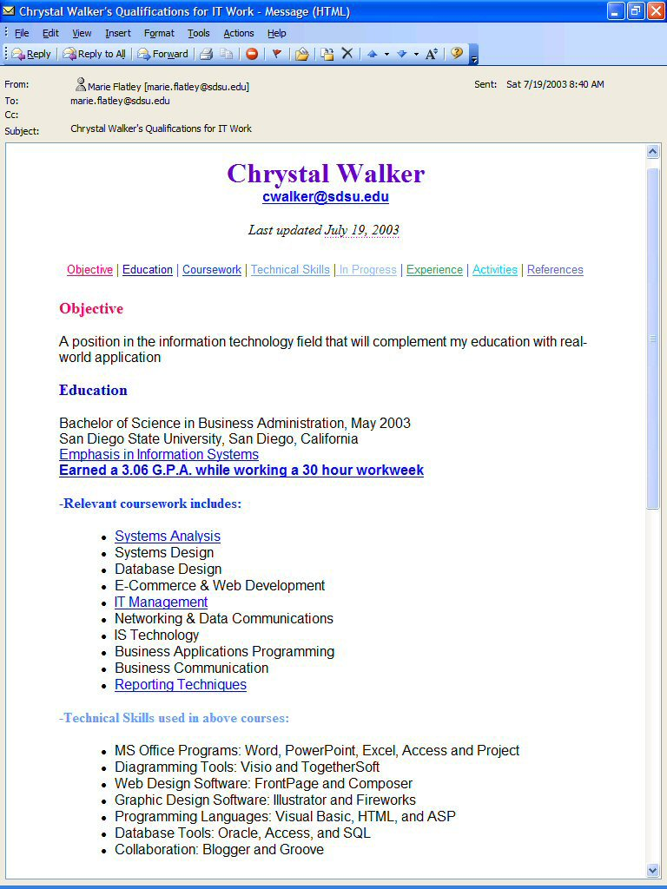
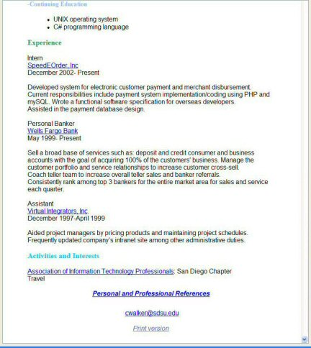
High-end Electronic Résumé Example
(explore from text web site)

Slide 19
The Reference Sheet
Check with references before listing them.
  Get permission as well as complete contact information.
Plan the arrangement and ordering.
  Use an organizational plan for arranging your list.
  Order references in a way that favors you.
Present it in good form.

Slide 20
Reference Sheet Example
Megan M. Adami
7165 Hermes Lane
New Berlin, IL 62670-3748
Voice/Message: 217.787.0445
Cell/Message: 217.456.2411
eFax: 954.301.4607
Email: meganadami@hotmail.com
Professional
References
Professor Rosemary Lenaghan (major professor)
Lincoln Land Community College
Accounting Department
5250 Shepherd Road
Springfield, IL 62794-9256
Email: Rosemary.Lenaghan@llcc.cc.il.us
Phone: 217.786.2259
Kathleen M. Kubicek, Director (internship supervisor)
Prevention First, Inc.
2800 Montvale Drive
Springfield, IL, 62704
Email: kkubicek@prevent.org
Phone: 217.793.7353, ext. 107
Personal
References
Terrence Patrick, co-worker at Prevention First, 217.568.5998
Matthew Gregory, life-long friend, 219.486.3396

Slide 21
Writing the Print Cover Message
Gain attention in the opening.
Select content.
Organize for conviction.
Drive for action in the close.

Slide 22
Print Cover Message Example (1 of 5)
Opening
[Sender’s Address]
[Date]
[Receiver’s Address]
Dear Mr. Guthrie:
Does your interest in employing an accountant, as indicated by your advertisement in today’s issue of the Post, center on finding a person who has had some experience in petroleum accounting, is college trained in accounting, and has demonstrated the ability to work with others?

Slide 23
Print Cover Message Example (2 of 5)
Body
With a background of three years as a part-time employee of the State Comptroller of Public Accounting and the State Auditor’s office, and with four years’ specialized training in the College of Business Administration at State University, I am the person who meets your requirements. As an auditor in both the state departments mentioned above, I participated in audits of the books of several oil firms and gained some familiarity with petroleum accounting procedures which should increase my usefulness in future work of this type.

Slide 24
Print Cover Message Example (3 of 5)
Body continued
In my intensive coursework at the University, I studied several phases of accounting (including petroleum, fiduciary, cost, and systems as well as theory and auditing) with the intention of obtaining a comprehensive and well-integrated background for competent work in the petroleum field. Please look at the attached résumé to note the additional courses with which I rounded out my training. The sincerity of my study efforts is evidenced by the B.B.A. degree with honors I was awarded this June.

Slide 25
Print Cover Message Example (4 of 5)
Body continued
With a view to the value of human relations in business, I actively participated in organizations such as Sigma Nu (social fraternity), intramural volleyball, Men’s Chorus, and Alpha Kappa Psi (professional fraternity). Through these associations I learned a lot about people and how to work with them. I am confident that I could work effectively with your accounting department staff.

Slide 26
Print Cover Message Example (5 of 5)
Closing
As my interests lie in useful and satisfying work in the field of petroleum accounting, may I meet you personally and talk with you? I can make myself available at any date convenient for you.
Sincerely,
[Your typed name]
enclosure

Slide 27
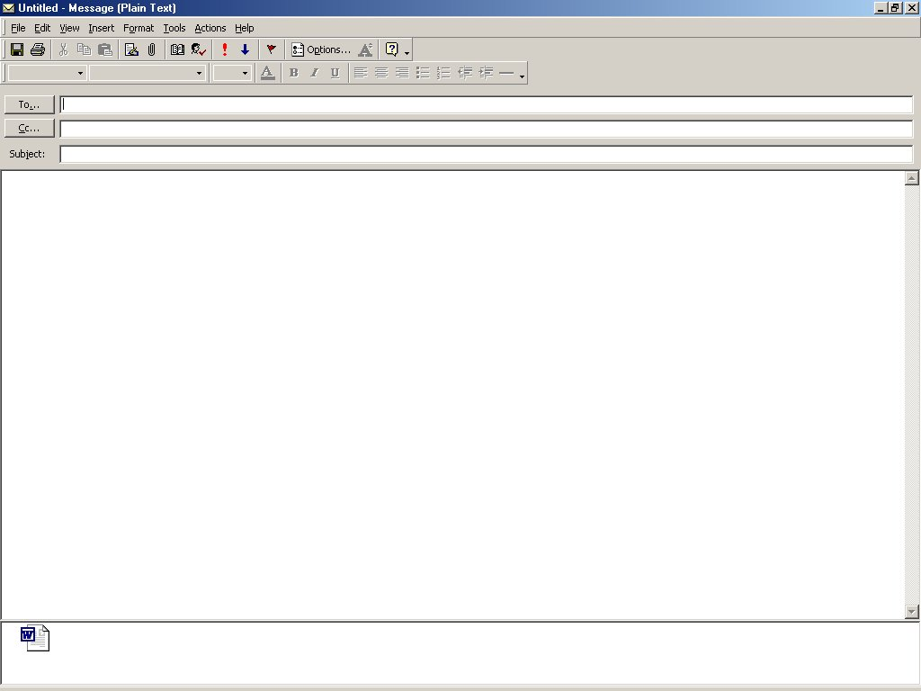
Ivan Streit
Your next organic sales representative
Mr. Streit,
The sales representative position your company recently created for its new line of organically grown products interests me. Both my education and personal interest qualify me for this position.
As you’ll see on the attached résumé, I will complete my degree this May from Iowa State in agriculture with a minor in environmental studies. While I grew up in Des Moines, I’ve always been interested in farming. In fact, last summer I spent three months working at an organic farm in Tennessee concentrating in soybeans and pecans. There I learned firsthand how organic foods are grown and harvested, giving me a depth of knowledge to draw on when talking to your potential customers about product quality.
Your decision to add this product line to your company recognizes the growing demand for organic foods as well as the need for a good channel of distribution, a channel I’d like to help you develop. I’ll call you next week so that we can arrange a time to talk further about the position.
Lydia Liedman
Liedman_…

Slide 28
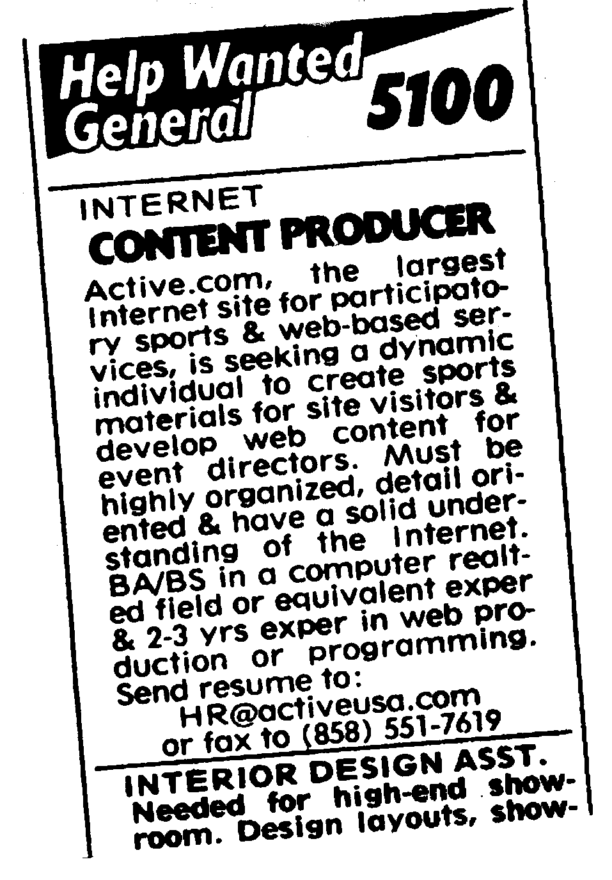
What is in this ad that you might use in your application message?
Communication Channel?
  Email or Fax
Nature of Business?
  Sports
Nature of Work?
  Writing/Computing
Education/Skills required?
  BA/BS in computer field or equivalent experience
  Experience in web production or programming
More information about company?
  http://www.active.com

Slide 29

Handling the Interview
Investigate the company.
Make a good appearance.
Anticipate questions and prepare answers.
Put yourself at ease.
Help control the dialogue.

Slide 30
Preparing your answers helps you choose a strategy
Question: What are your weaknesses?
Possible Strategies:
Present a weakness that’s really a hidden strength.
Cite a corrected weakness.
Recall a lesson learned.
Reveal a lapsed skill.
Use an unrelated skill.
Cite an objective.
Try humor.
Repeat your qualifications.

Slide 31
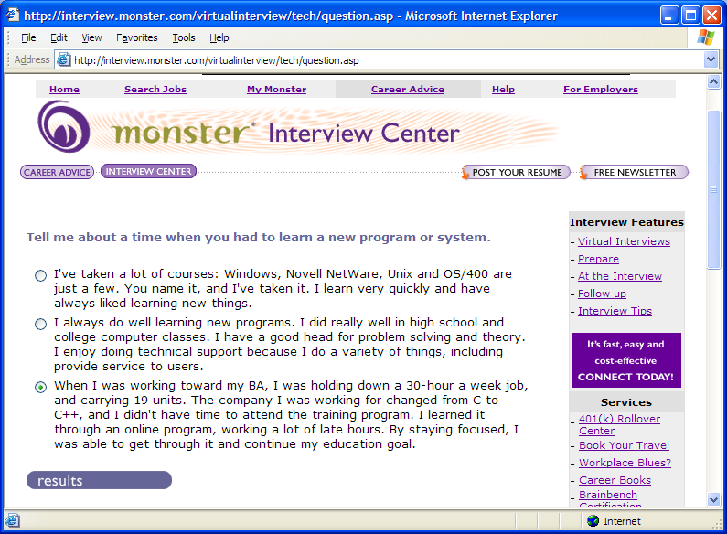
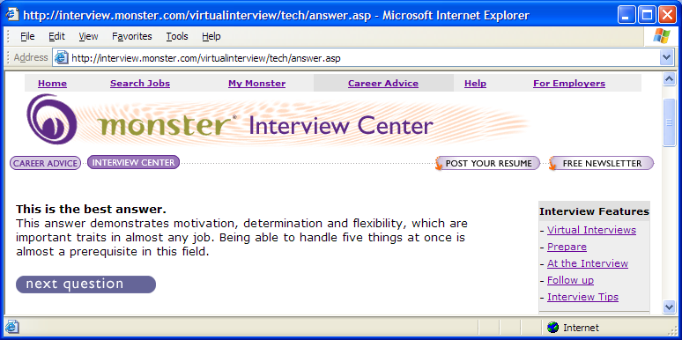
Practice with Interactive Tools

Slide 32
Writing Other Job Search Messages
Thank-you message
Follow-up message
Job acceptance message
Job refusal message
Job resignation message

Slide 33
Thank you Message Example
Dear Ms. Munson:
Your bank and the job opportunities we discussed recently continue to interest me, especially the Financial Analyst position.
I believe that my finance major, internship, and my immersion semester in Brazil highly qualify me for the position. These qualifications have given me the computer skills, hands-on experience, and interpersonal skills useful in your domestic operations. My extensive travel and cultural knowledge of South America will be valuable in your planned expansion there.
I’m looking forward to hearing from you soon. If you have any other questions, feel free to contact me at zekesmith@hotmail.com.
Zeke Smith

Slide 34

Continuing Job Search Activities
Maintain your résumé
Read job ads/ professional
journals

Slide 35
"Choose a job you love, and you will never have to work a day in your life."
- Confucius -

